Slide 1
Building CI/CD workflows for serverless applications

Slide 2
Agenda
Building CI/CD workflows for serverless applications
100 – Starting right
200 – Safe deployments
300 – AWS CodeSuite services
400 – Custom pipelines
Secrets and configuration
Additional resources
Q&A

Slide 3






What is CI/CD?
Continuous integration
Approved deploy
Continuous delivery
Automated deploy
Continuous deployment
automated
automated
automated
Source Control
Build
Staging
Production

Slide 4
100 – Starting right

Slide 5
AWS Lambda applications
Get you building quickly with:
Lambda functions
Triggers
Resources
A continuous delivery pipeline in a single repository.

Slide 6
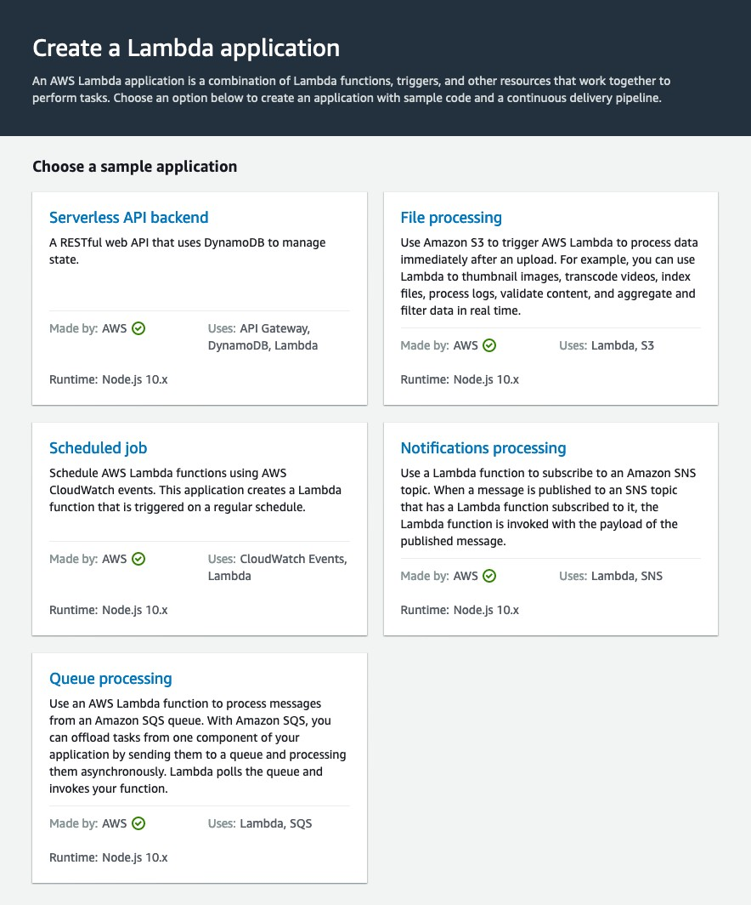
AWS Lambda applications
Sample applications:
Serverless API backend
File processing
Scheduled job
Notifications processing
Queue processing

Slide 7
AWS Lambda applications
Author from scratch:
Code repository
Continuous delivery pipeline
AWS SAM template
AWS IAM role and permissions boundary
A single Lambda function

Slide 8
200 – Safe deployments

Slide 9

Meet AWS SAM
AWS Serverless Application Model
Can mix in other traditional CloudFormation resources in the same template
i.e. Amazon S3, Amazon Kinesis, AWS Step Functions
Supports use of Parameters, Mappings, Outputs
Supports Intrinsic Functions
Can use ImportValue
(exceptions for RestApiId, Policies, StageName attributes)

Slide 10
AWS SAM templates
AWSTemplateFormatVersion: '2010-09-09’ Transform: AWS::Serverless-2016-10-31 Resources:
GetProductsFunction:
Type: AWS::Serverless::Function Properties:
Handler: index.getProducts Runtime: nodejs10.x CodeUri: src/
Policies:
- DynamoDBReadPolicy:
TableName: !Ref ProductTable Events:
GetResource: Type: Api Properties:
Path: /products/{productId} Method: get
ProductTable:
Type: AWS::Serverless::SimpleTable
Just 20 lines to create:
Lambda function
IAM role
API Gateway
DynamoDB table

Slide 11



AWS SAM templates
AWSTemplateFormatVersion: '2010-09-09’ Transform: AWS::Serverless-2016-10-31 Resources:
GetProductsFunction:
Type: AWS::Serverless::Function Properties:
Handler: index.getProducts Runtime: nodejs10.x CodeUri: src/
Policies:
- DynamoDBReadPolicy:
TableName: !Ref ProductTable Events:
GetResource: Type: Api Properties:
Path: /products/{productId} Method: get
ProductTable:
Type: AWS::Serverless::SimpleTable
AWS Cloud
Allowing
Amazon API Gateway
this
===
To become this
Lambda function
Table
Role

Slide 12
AWS SAM safe deployments
Deploy gradually
Canary deployments
Linear deployments
Test in production

Slide 13


AWS Lambda alias traffic shifting & AWS SAM
When you add the AutoPublishAlias property and specify an alias name, AWS SAM does the following:
Deployment preference type
Canary10Percent5Minutes
Canary10Percent10Minutes
Canary10Percent15Minutes
Canary10Percent30Minutes
Linear10PercentEvery1Minute
Linear10PercentEvery2Minutes
Linear10PercentEvery3Minutes
Linear10PercentEvery10Minutes
AllAtOnce
Detect when new code is being deployed based on changes to the Lambda function's Amazon S3 URI.
Create and publish an updated version of that function with the latest code.
Create an alias with a name you provide (unless an alias already exists) and point that alias to the updated version of your Lambda function.

Slide 14
Example AWS SAM resource
SomeFunction:
Type: AWS::Serverless::Function Properties:
Handler: somefunction Runtime: go1.x
AutoPublishAlias: !Ref ENVIRONMENT DeploymentPreference:
Type: Canary10Percent15Minutes
# Type: Linear10PercentEvery10Minutes Alarms:
# Canary example
# Linear example
# A list of alarms that you want to monitor
!Ref AliasErrorMetricGreaterThanZeroAlarm
!Ref LatestVersionErrorMetricGreaterThanZeroAlarm Hooks:
# Validation Lambda functions that are run before & after traffic shifting PreTraffic: !Ref PreTrafficLambdaFunction
PostTraffic: !Ref PostTrafficLambdaFunction

Slide 15


AWS Lambda Alias Traffic Shifting & AWS SAM
In SAM:
Alarms:
# A list of alarms that you want to monitor
!Ref AliasErrorMetricGreaterThanZeroAlarm
!Ref LatestVersionErrorMetricGreaterThanZeroAlarm Hooks:
# Validation Lambda functions that are run before & after traffic shifting PreTraffic: !Ref PreTrafficLambdaFunction
PostTraffic: !Ref PostTrafficLambdaFunction
BeforeAllowTraffic
AllowTraffic
Note: You can specify a maximum of 10 alarms
AfterAllowTraffic

Slide 16
AWS SAM safe deployments
Built using AWS CodeDeploy, an AWS CodeSuite service.
What other AWS CodeSuite services are available?

Slide 17
300 – AWS CodeSuite services

Slide 18
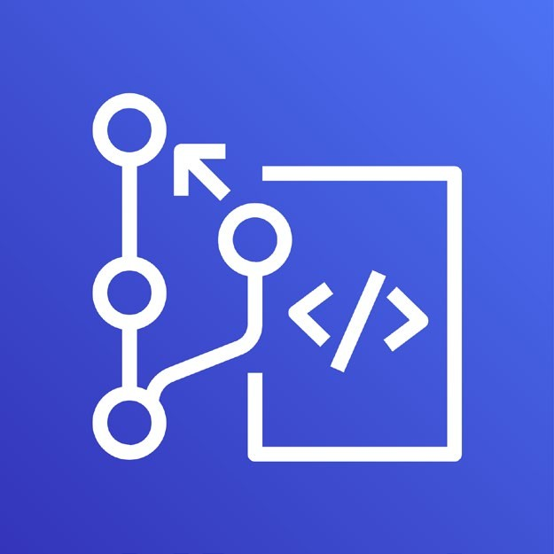
AWS CodeCommit
Fully managed git repositories
Automatically encrypts your files in transit and at rest
Works with AWS Identity and Access Management (IAM)

Slide 19
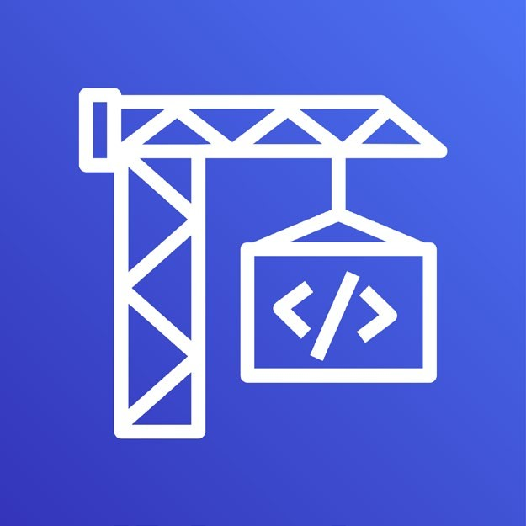
AWS CodeBuild
Fully managed build service that can compile source code, run tests, and produce software packages
Scales continuously and processes multiple builds concurrently
Can consume environment variables from AWS SSM Parameter Store
Supports dependency caching

Slide 20

AWS CodeDeploy
Fully managed deployment service
Automates deployments to Amazon EC2, AWS Fargate, AWS Lambda, and on-premises servers
Foundation of AWS SAM safe deployments

Slide 21
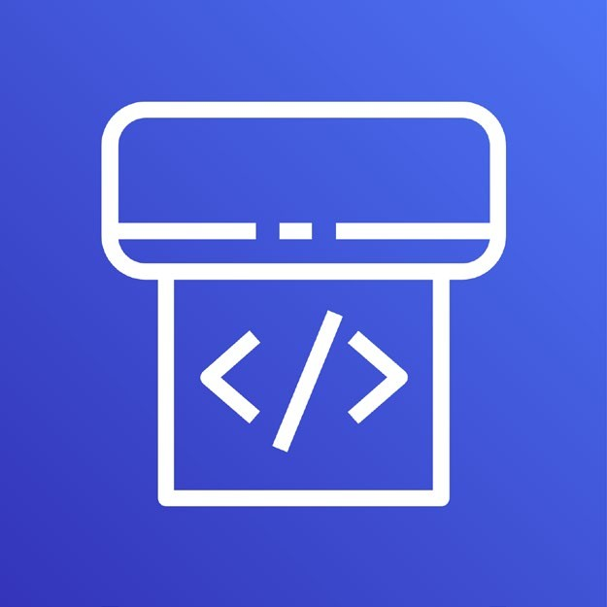
AWS CodePipeline
Continuous delivery service for fast and reliable application updates
Model and visualize your software release process
Builds, tests, and deploys your code every time there is a code change

Slide 22
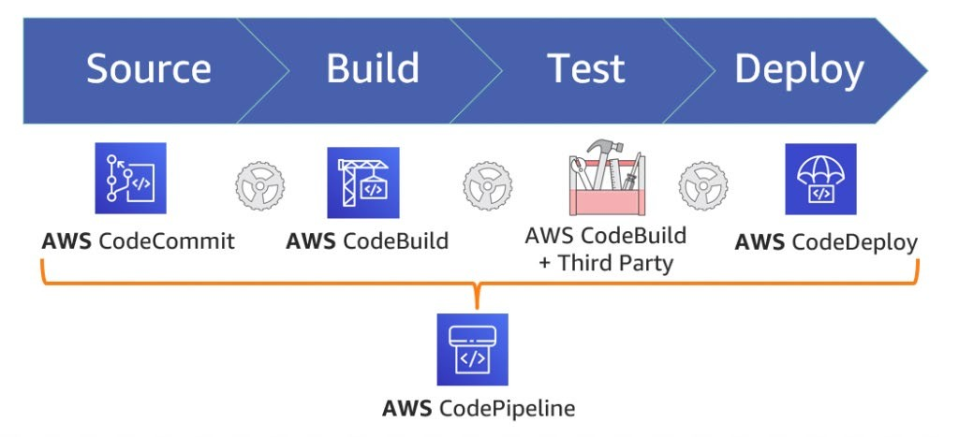
AWS CodeSuite

Slide 23
AWS Partner Network
Bring the tools and services you use today
CodeBuild builds from repositories in GitHub and Atlassian Bitbucket
CodePipeline offers integrations with CloudBees, Jenkins, TeamCity, and more
CircleCI provides an AWS SAM orb to simplify your builds

Slide 24
400 – Custom pipelines

Slide 25
CodePipeline and AWS Step Functions
Invoke more complex workflows as part of your release process
Robust error handling and retries
Rich visualizations and logging
Asynchronous and manual tasks
Not a replacement for CodeBuild – a new superpower! s12d.com/codepipeline-stepfunctions

Slide 26
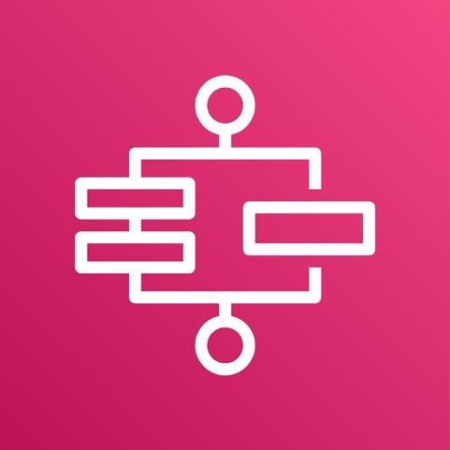
What is AWS Step Functions?
Serverless workflows that help you:
Build and update apps quickly
Improve resiliency
Write less code
Orchestrate long-running tasks
Modernize monoliths
Integrate with managed services
Handle errors and retries
AWS Step Functions

Slide 27
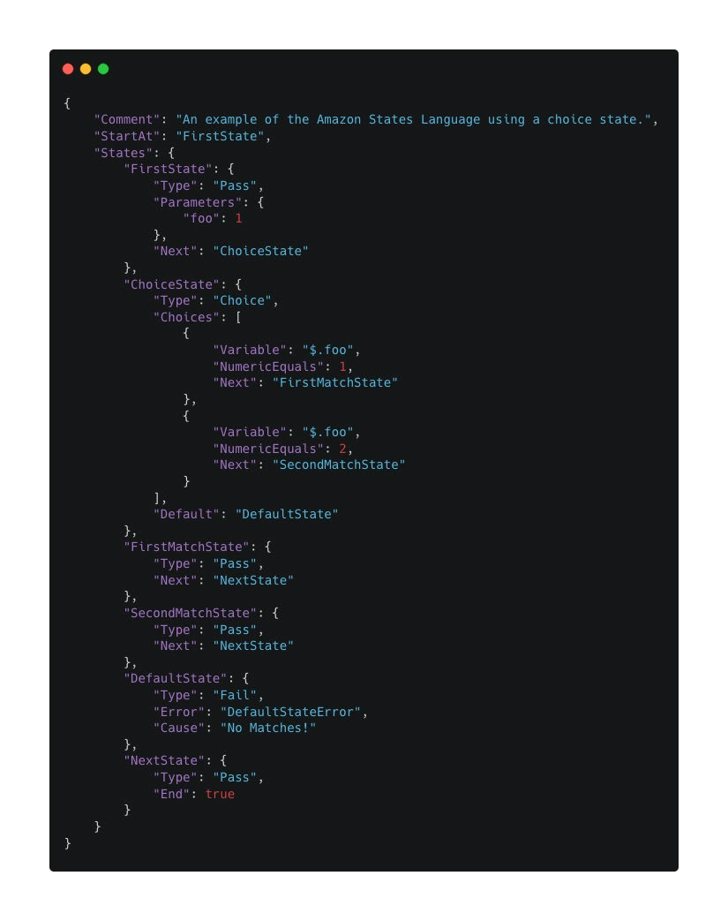
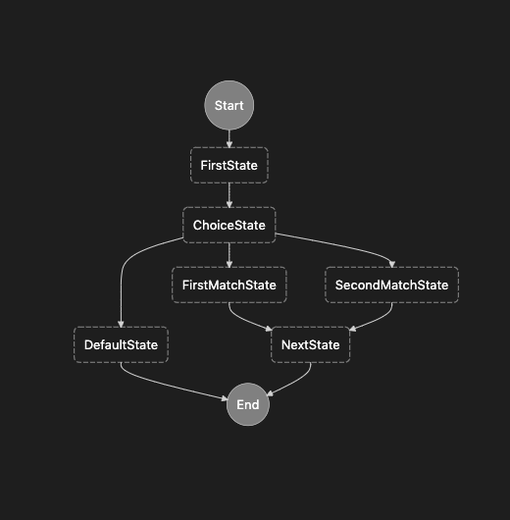
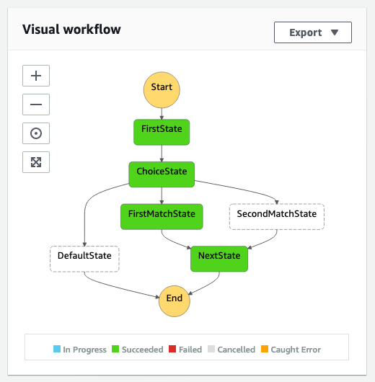
Serverless workflows
Define
Visualize
Monitor

Slide 28
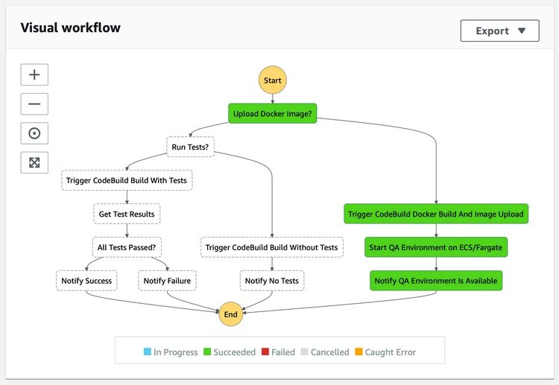
AWS Step Functions and AWS CodeBuild
Start builds periodically or in response to events with Amazon EventBridge
Create webhooks to start builds using Amazon API Gateway
Parallel State for independent components
Map State for each branch

Slide 29
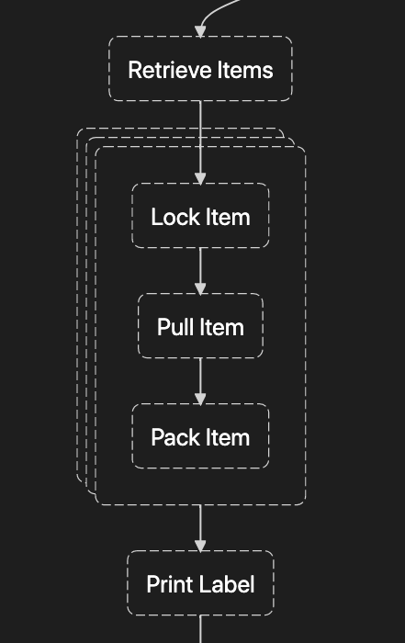
Dynamic parallelism
“Map State”
Run identical tasks in parallel
Fanout pattern – dispatch a list of identical tasks to simplify workflows like order processing and instance management
Scatter-gather pattern – accelerate workflows such as file processing

Slide 30
Custom pipelines – use cases
Provisioning complex infrastructure for deployment environments
Publishing artifacts to multiple AWS Regions
Multi-layer manual approvals
Periodic builds
Not a replacement for CodePipeline – a new superpower! s12d.com/stepfunctions-codebuild

Slide 31
Secrets and configuration

Slide 32

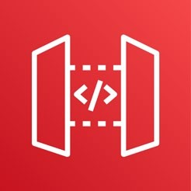
Secrets
AWS SAM
Parameters
Support default values, data type, and allowed values
Can be overridden on deployment
Can be passed to Lambda functions as environment variables
Stage Variables
Parameter Store
Accessible from AWS SAM template at deployment time
Accessible from code at runtime
Supports encrypted values
Account specific
Declared in API Gateway
Use in stage specific situations
Can be overridden in Canary releases

Slide 33

AWS AppConfig
Create, manage, and deploy application configurations
Built-in validation checks and monitoring
Integrated deploy action for CodePipeline

Slide 34
AWS AppConfig Lambda extension
Enables updating Lambda function configuration parameters without redeploying your function
Simplifies using AWS AppConfig while reducing costs
Fewer API calls to the AWS AppConfig service
Reduced costs from shorter Lambda function processing times
s12d.com/appconfig-extension

Slide 35
Additional resources

Slide 36
Additional resources
APN Partners for CI/CD
s12d.com/cicd-partners
AWS Serverless website
serverlessland.com
AWS Serverless YouTube channel
youtube.com/c/ServerlessLand

Slide 37
Closing

Slide 38
Review
Building CI/CD workflows for serverless applications
100 – Starting right
200 – Safe deployments
300 – AWS CodeSuite services
400 – Custom pipelines
Secrets and configuration
Additional resources
Q&A

Slide 39
Thank you!
serverlessland.com

